Slide 1
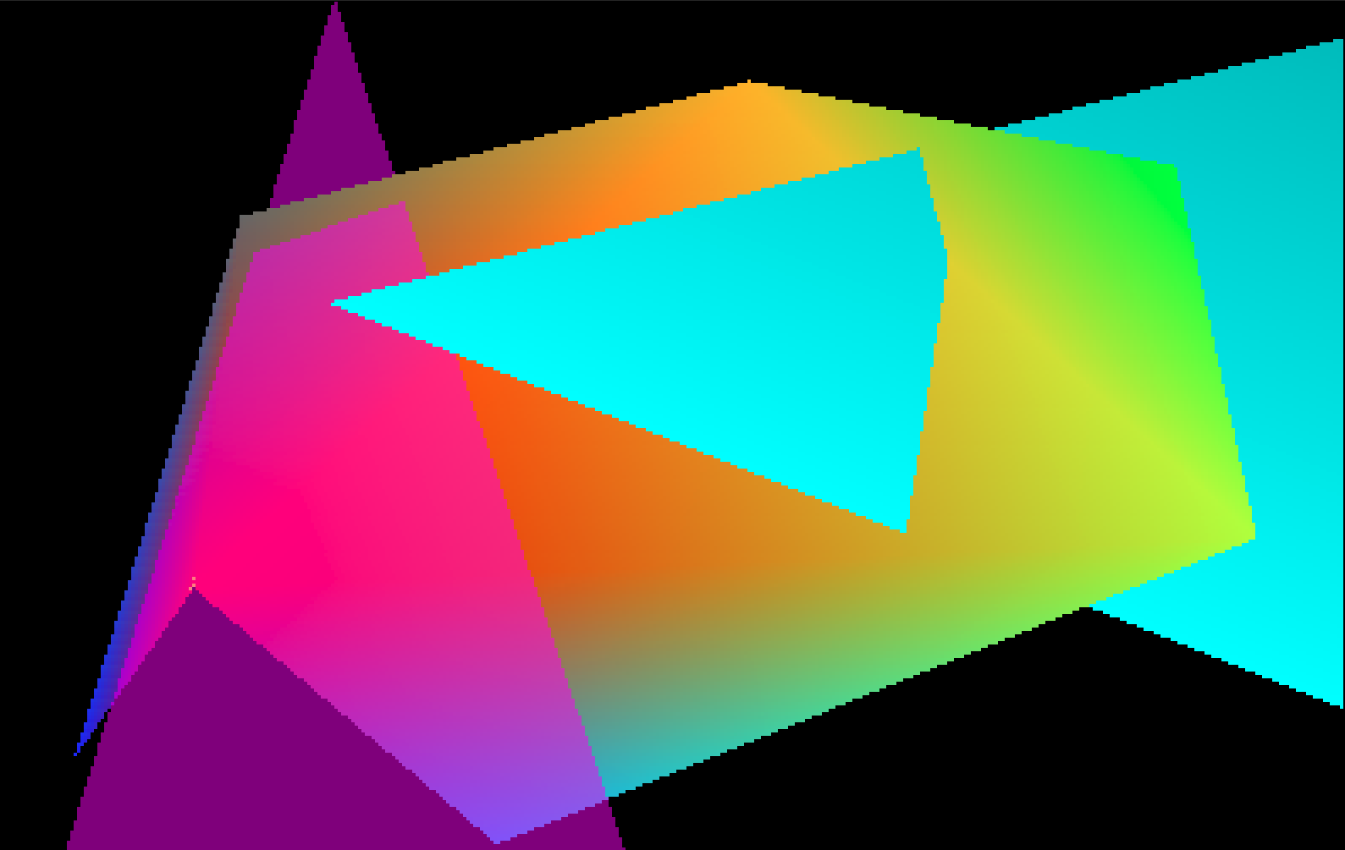

Slide 2
Transparency works here because the single transparent triangle KLM was last in the list of triangles, so it could be composited correctly over all the opaque triangles that are behind it. If there are multiple transparent surfaces, they must be composited in back to front order, so that any triangle is correctly composited in front of any surfaces that should appear behind it. The blue square is at the back, the green triangle is in the middle, and the red square is in the front. On the left, they are rendered in that order. But on the right, they are rendered in the order blue, red, and green, and the tip of the green triangle is cut off by the depth test.

Slide 3

The are bright pixels that are composited twice. Why?

Slide 4
The edge with doubled pixels belongs to triangle ABC, or 0 1 2, and also to triangle BEC, or 1 4 2.
B:1
E:4
C:2
A:0

Slide 5
Data in RevisedGeometryTriangles.cpp, with no horizontal or vertical edges
int triangles[5][3] = {
{0, 1, 2}, // ABC
{0, 3, 1}, // ADB
{1, 4, 2}, // BEC
{0, 2, 5}, // ACF
{0, 3, 6} // ADG
};
double vertices[8][2] = {
{60.5, 175.5}, // A 0
{224.5, 325.5}, // B 1
{374.5, 190.5}, // C 2
{74.5, 285.5}, // D 3
{350.5, 300.5}, // E 3
{150., 100.}, // F 5
{ 25., 125.}, // G 6
{0., 0.} // Q 7
};

Slide 6
Data in RevisedGeometryTriangles.cpp
With no horizontal or vertical edges
int triangles[5][3] = {
{0, 1, 2}, // ABC
{0, 3, 1}, // ADB
{1, 4, 2}, // BEC
{0, 2, 5}, // ACF
{0, 3, 6} // ADG
};
double vertices[8][2] = {
{60.5, 175.5}, // A 0
{224.5, 325.5}, // B 1
{374.5, 190.5}, // C 2
{74.5, 285.5}, // D 3
{350.5, 300.5}, // E 3
{150., 100.}, // F 5
{ 25., 125.}, // G 6
{0., 0.} // Q 7
};
Edge BC is the common edge to triangles ABC and BEC. It connects B = (224.5, 325.5) to C = (374.5, 190.5). On this edge, the slope of x as a function of y is
x2 – x1 374.5 – 224.5
y2 – y1 190.5 – 325.5
150 15 x 10 10
-135 15 x 9 9
The line starts at a pixel center B. Every time y decreases by 9 scan lines, the line passes through a new pixel center, 10 pixels to the right.
=
=
= -
= -

Slide 7
int set_pixel_alpha(int x, int y, double r, double g, double b, double a) {
int index, bad = 0;
float transparency = 1 - a;
if (x >= 0 && x < width && y >= 0 && y < height) {
index = 3*(x + width*y);
if (image[index + 2] != 0)
bad = 1;
image[index ] = (unsigned char) (255*a*r + transparency*(float) image[index ]);
image[index+1] = (unsigned char) (255*a*g + transparency*(float) image[index+1]);
image[index+2] = (unsigned char) (255*a*b + transparency*(float) image[index+2]);
}
return bad;
}
void draw_horizontal_edge_triangle(int i1, int i2, int i3, int kind) { ...
for (y = i_top + .5; y > bottom_y; y -= 1) {
xleft = m_left*y + b_left;
xright = m_right*y + b_right;
for (x = i_left + .5; x < xright; x += 1) {
bad = set_pixel_alpha((int)floor(x), (int)floor(y), r, g, b, a)
if (bad)
printf("x %f y %f xleft %22.18g xright %22.18g\n", x, y, xleft, xright);
}
}
}

Slide 8
Triangle ABC drawn last, so prints from doubled pixels show its data
i 0 j 0 index 0 A vertex 60.500000 175.500000
i 0 j 1 index 1 B vertex 224.500000 325.500000
i 0 j 2 index 2 C vertex 374.500000 190.500000
x 234.500000 y 316.500000 xleft 214.659999999999968 xright 234.500000000000057
x 244.500000 y 307.500000 xleft 204.819999999999993 xright 244.500000000000057
x 254.500000 y 298.500000 xleft 194.979999999999961 xright 254.500000000000057
x 264.500000 y 289.500000 xleft 185.139999999999986 xright 264.500000000000057
x 274.500000 y 280.500000 xleft 175.300000000000011 xright 274.500000000000057
x 284.500000 y 271.500000 xleft 165.459999999999980 xright 284.500000000000057
x 294.500000 y 262.500000 xleft 155.620000000000005 xright 294.500000000000057
x 304.500000 y 253.500000 xleft 145.779999999999973 xright 304.500000000000057
x 314.500000 y 244.500000 xleft 135.939999999999998 xright 314.500000000000057
x 324.500000 y 235.500000 xleft 126.099999999999966 xright 324.500000000000057
x 334.500000 y 226.500000 xleft 116.259999999999991 xright 334.500000000000057
x 344.500000 y 217.500000 xleft 106.419999999999987 xright 344.500000000000057
x 354.500000 y 208.500000 xleft 96.5799999999999841 xright 354.500000000000057
x 364.500000 y 199.500000 xleft 86.7399999999999807 xright 364.500000000000057

Slide 9
Triangle BEC drawn last, so prints from doubled pixels show its data
i 2 j 0 index 1 B vertex 224.500000 325.500000
i 2 j 1 index 4 E vertex 350.500000 300.500000
i 2 j 2 index 2 C vertex 374.500000 190.500000
x 234.500000 y 316.500000 xleft 234.5 xright 269.859999999999900
x 244.500000 y 307.500000 xleft 244.5 xright 315.220000000000027
x 254.500000 y 298.500000 xleft 254.499999999999943 xright 350.936363636363637
x 264.500000 y 289.500000 xleft 264.499999999999943 xright 352.899999999999977
x 274.500000 y 280.500000 xleft 274.499999999999943 xright 354.863636363636374
x 284.500000 y 271.500000 xleft 284.499999999999943 xright 356.827272727272714
x 294.500000 y 262.500000 xleft 294.499999999999943 xright 358.790909090909111
x 304.500000 y 253.500000 xleft 304.499999999999943 xright 360.754545454545450
x 314.500000 y 244.500000 xleft 314.499999999999943 xright 362.718181818181847
x 324.500000 y 235.500000 xleft 324.499999999999943 xright 364.681818181818187
x 334.500000 y 226.500000 xleft 334.499999999999943 xright 366.645454545454527
x 344.500000 y 217.500000 xleft 344.499999999999943 xright 368.609090909090924
x 354.500000 y 208.500000 xleft 354.499999999999943 xright 370.572727272727263
x 364.500000 y 199.500000 xleft 364.499999999999886 xright 372.536363636363660

Slide 10
Triangle ABC, edge BC
x 234.500000 xright 234.500000000000057
x 244.500000 xright 244.500000000000057
x 254.500000 xright 254.500000000000057
x 264.500000 xright 264.500000000000057
x 274.500000 xright 274.500000000000057
x 284.500000 xright 284.500000000000057
x 294.500000 xright 294.500000000000057
x 304.500000 xright 304.500000000000057
x 314.500000 xright 314.500000000000057
x 324.500000 xright 324.500000000000057
x 334.500000 xright 334.500000000000057
x 344.500000 xright 344.500000000000057
x 354.500000 xright 354.500000000000057
x 364.500000 xright 364.500000000000057
Triangle BEC, edge BC
x 234.500000 xleft 234.5
x 244.500000 xleft 244.5
x 254.500000 xleft 254.499999999999943
x 264.500000 xleft 264.499999999999943
x 274.500000 xleft 274.499999999999943
x 284.500000 xleft 284.499999999999943
x 294.500000 xleft 294.499999999999943
x 304.500000 xleft 304.499999999999943
x 314.500000 xleft 314.499999999999943
x 324.500000 xleft 324.499999999999943
x 334.500000 xleft 334.499999999999943
x 344.500000 xleft 344.499999999999943
x 354.500000 xleft 354.499999999999943
x 364.500000 xleft 364.499999999999886

Slide 11
When dividing a general triangle in two by a horizontal line, interpolate the attributes to Qmiddle.
Draw a horizontal line though Pmiddle, which intersects edge Ptop Pbottom at Qmiddle.
Interpolate the attributes at Ptop and Pbottom to Qmiddle along the edge Ptop Pbottom.
Ptop
Pmiddle
Qmiddle
Pbottom

Slide 12
The edge with doubled pixels belongs to triangle ABC, or 0 1 2, and also to triangle BEC, or 1 4 2, which is divided into two triangles by the horizontal line EQ through E, into two triangles: BQE, or 1 7 4, and EQC, or 4 7 2.
B:1
E:4
Q:7
C:2
A:0

Slide 13
void draw_horizontal_edge_triangle(int i1, int i2, int i3, int kind) {
double m_left, b_left, m_right, b_right, x, y, top_y, bottom_y, xleft, xright;
int i_top, i_left, db_horizontal = 0, db_double = 0, bad;
if (kind) { // top vertex i1 belongs to both non-horizontal edges
if (vertices[i2][0] < vertices[i3][0]) { // vertex i2 is on the left
get_x_line_equation(i1, i2, &m_left, &b_left);
get_x_line_equation(i1, i3, &m_right, &b_right);
}
else { // vertex i3 is on the left
get_x_line_equation(i1, i3, &m_left, &b_left);
get_x_line_equation(i1, i2, &m_right, &b_right);
}
}
else { // bottom vertex i3 is on both both non-horizontal edges
if (vertices[i1][0] < vertices[i2][0]) { // vertex i1 is on the left
get_x_line_equation(i1, i3, &m_left, &b_left);
get_x_line_equation(i2, i3, &m_right, &b_right);
}
else { // vertex i2 is on the left
get_x_line_equation(i2, i3, &m_left, &b_left);
get_x_line_equation(i1, i3, &m_right, &b_right);
}
}

Slide 14
if (kind) { // top vertex i1 belongs to both non-horizontal edges
if (vertices[i2][0] < vertices[i3][0]) { // vertex i2 is on the left
get_line_equation(y1, y2, x1, x2, &m_left, &b_left);
get_line_equation(y1, y3, x1, x3, &m_right, &b_right);
if (db_horizontal) {
printf("left line %d %d m %g b %g\n", i1, i2, m_left, b_left);
printf("right line %d %d m %g b %g\n", i1, i3, m_right, b_right);
}
}
else { // vertex i3 is on the left
get_line_equation(y1, y3, x1, x3, &m_left, &b_left);
get_line_equation(y1, y2, x1, x2, &m_right, &b_right);
if (db_horizontal) {
printf("left line %d %d m %22.18g b %22.18g\n", i1, i3, m_left, b_left);
printf("right line %d %d m %22.18g b %22.18g\n", i1, i2, m_right, b_right);
}
}
}
else { // bottom vertex i3 is on both non-horizontal edges ...

Slide 15
Triangle ABC
left line 1 7 m 1.09333333333333327 b -131.379999999999995
right line 1 2 m -1.11111111111111116 b 586.166666666666742
left line 7 0 m 1.09333333333333371 b -131.380000000000081
right line 2 0 m 20.9333333333333336 b -3613.30000000000018
Triangle BEC
left line 1 7 m -1.11111111111111316 b 586.166666666667311
right line 1 4 m -5.04000000000000004 b 1865.01999999999998
left line 7 2 m -1.11111111111111072 b 586.166666666666515
right line 4 2 m -0.218181818181818171 b 416.063636363636363

Slide 16
Triangle ABC, or 0 1 2
right line 1 2 m -1.11111111111111116 b 586.166666666666742
Triangle BEC, or 1 4 2
left line 1 7 m -1.11111111111111316 b 586.166666666667311
left line 7 2 m -1.11111111111111072 b 586.166666666666515
B:1
E:4
Q:7
C:2
A:0

Slide 17
Triangle ABC, or 0 1 2
right line 1 2 m -1.11111111111111116 b 586.166666666666742
Triangle BEC, or 1 4 2
left line 1 7 m -1.11111111111111316 b 586.166666666667311
left line 7 2 m -1.11111111111111072 b 586.166666666666515
B:1
E:4
Q:7
C:2
A:0

Slide 18
void draw_horizontal_edge_triangle(int i1, int i2, int i3, int kind,
int side, double m, double b) {
if (kind) { // top vertex i1 belongs to both non-horizontal edges
if (vertices[i2][0] < vertices[i3][0]) { // i2 is on the left
get_x_line_equation(i1, i2, &m_left, &b_left);
get_x_line_equation(i1, i3, &m_right, &b_right);
}
else { // vertex i3 is on the left
...
if (side == 1) {
m_left = m;
b_left = b;
}
else if (side == 2) {
m_right = m;
b_right = b;
}

Slide 19
if (vertex[top_index][1] == vertex[bottom_index][1])
return; // zero height triangle
if (vertex[middle_index][1] == vertex[top_index][1]) {
draw_horizontal_edge_triangle(index[top_index], index[middle_index], index[bottom_index], 0, 0, 0, 0);
return;
}
else if (vertex[middle_index][1] == vertex[bottom_index][1]) {
draw_horizontal_edge_triangle(index[top_index], index[middle_index], index[bottom_index], 1, 0, 0, 0);
return;
}

Slide 20
// We need to cut the triangle in two with a horizontal line.
// First find line equation for the line between the top and bottom vertices.
get_x_line_equation(index[top_index], index[bottom_index], &m, &b);
xmiddle = vertices[index[middle_index]][0];
ymiddle = vertices[index[middle_index]][1];
if (xmiddle > m*ymiddle + b)
side = 1; // indicates on which side to use long edge m and b parameters
else
side = 2;
vertices[7][0] = m*ymiddle + b;
vertices[7][1] = ymiddle;
draw_horizontal_edge_triangle(index[top_index], index[middle_index], 7, 1,
side, m, b);
draw_horizontal_edge_triangle(index[middle_index], 7, index[bottom_index], 0,
side, m, b);
}

Slide 21
void draw_horizontal_edge_triangle(int i1, int i2, int i3, int kind,
int side, double m, double b) {
...
else { // vertex i2 is on the left
get_line_equation(i2, i3, &m_x_left, &b_x_left);
get_line_equation(i1, i3, &m_x_right, &b_x_right);
}
}
if (side == 1) {
m_x_left = m;
b_x_left = b;
}
else if (side == 2) {
m_x_right = m;
b_x_right = b;
}

Slide 22
Announcements
Open book midterm at 11:00 AM on Monday October 24
Please check your Teams and Outlook messages for class notices sent between class sessions, for example, about today’s class time and about the midterm rules.
Please set up your .html file for WebGL homework so that it looks for the utility files from the book either in the current directory, or in the ../lib/ directory as the book’s .html files do. I deducted 0.25 points last time for my effort in editing your .html files if you used something else, like ./lib or lib/ . I will deduct more in the future.

Slide 23
I will explain my ZbufferTriangles.cpp code.
It computes the 2D interpolated z for each pixel using successive 1D interpolations and uses the Zbuffer to decide which surfaces are closest.
It uses a different constant color for each polygon, so you still need to add the RGBA color interpolation. You can do it the same way that ZbufferTriangles.cpp interpolates the z.
If you choose to use your own code, I recommend first trying it on the revised five triangle data in RevisedGeometryTriangles.cpp, to make sure that it works on general triangles without horizontal or vertical edges. In the data for the homework, triangle HIJ extend offscreen so make sure that your code does not try to set offscreen pixels.

Slide 24
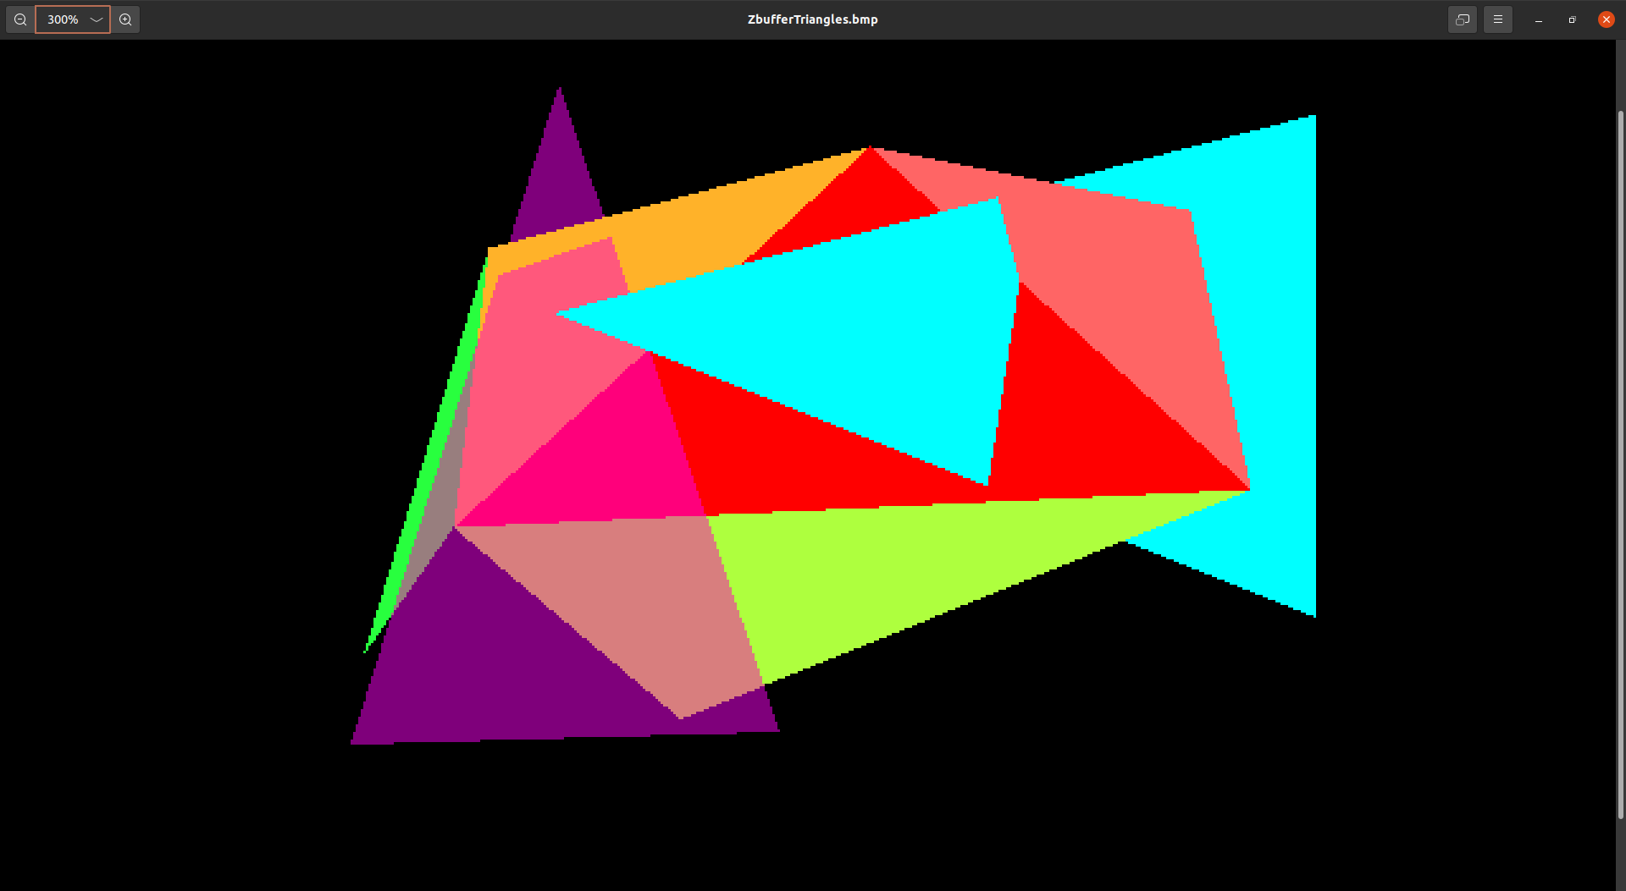
Output of ZBufferTriangles.cpp:

Slide 25
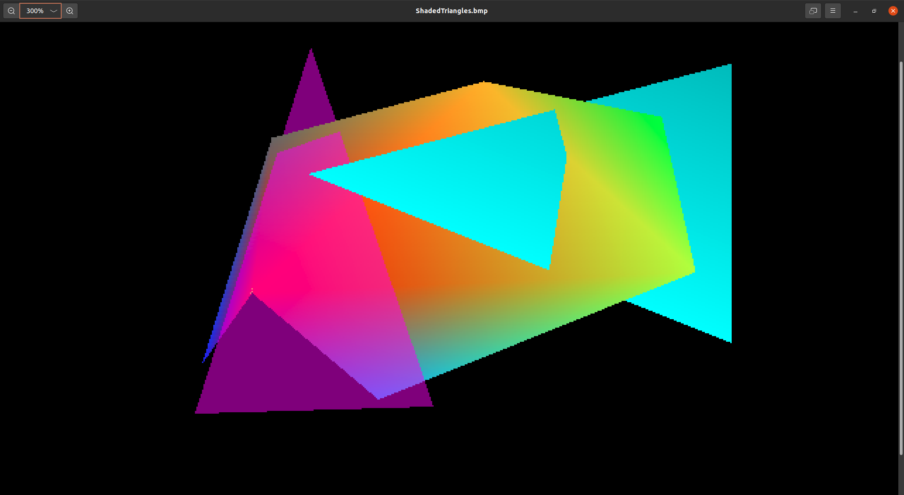
Desired output for homework 4:

Slide 26
Outline of ZBufferTriangles.cpp
For each triangle, draw_triangle() sorts the vertices in decreasing y order using if tests to separate 6 blocks of code, which set indices top_index, middle_index, and bottom_index.
If there is already a horizontal edge, it calls draw_horizontal_edge_triangle() one time.
Otherwise, it interpolates both x and z to the new vertex Q, and calls draw_horizontal_edge_triangle() twice. (Interpolated x is not used.)
draw_horizontal_edge_triangle() interpolates x and z along the left and right edges. It has a new parameter to specify the triangle index.
Then it interpolates z along the scan line between xleft and xright, and calls set_pixel_alpha_z((int)floor(x), (int)floor(y), r, g, b, a, z), using the constant rgba color determined by the triangle index.

Slide 27
For each triangle, draw_triangle sorts the vertices in decreasing y order using if tests to separate 6 blocks of code, which set indices top_index, middle_index, and bottom_index.

Slide 28
y0 = vertex[0][1];
y1 = vertex[1][1];
y2 = vertex[2][1];
if (y0 > y1) {
if (y0 > y2) { // y0 is highest
if (y1 > y2) { // y1 is second highest
top_index = 0;
middle_index = 1;
bottom_index = 2;
}
else { // y2 is second highest
top_index = 0;
middle_index = 2;
bottom_index = 1;
}
}
else if (y2 > y0) { // y2 is highest and y0 is second highest ...

Slide 29
If there is already a horizontal edge, it calls
draw_horizontal_edge_triangle() one time.
if (vertex[top_index][1] == vertex[bottom_index][1])
return; // zero height triangle
if (vertex[middle_index][1] == vertex[top_index][1]) {
draw_horizontal_edge_triangle(index[top_index], index[middle_index],
index[bottom_index], 0, 0, 0, 0, i);
return;
}
else if (vertex[middle_index][1] == vertex[bottom_index][1]) {
draw_horizontal_edge_triangle(index[top_index], index[middle_index], index[bottom_index], 1, 0, 0, 0, i);
return;
}

Slide 30
Otherwise, it interpolates both x and z to the new vertex Q, and calls draw_horizontal_edge_triangle() twice.

Slide 31
get_line_equation(vertex[top_index][1], vertex[bottom_index][1],
vertex[top_index][0], vertex[bottom_index][0], &m_x, &b_x);
get_line_equation(vertex[top_index][1], vertex[bottom_index][1],
vertex[top_index][2], vertex[bottom_index][2], &m_z, &b_z);
xmiddle = vertices[index[middle_index]][0];
ymiddle = vertices[index[middle_index]][1];
if (xmiddle > m_x*ymiddle + b_x)
side = 1;
else
side = 2;
vertices[13][0] = m_x*ymiddle + b_x;
vertices[13][1] = ymiddle;
vertices[13][2] = m_z*ymiddle + b_z;
draw_horizontal_edge_triangle(index[top_index], index[middle_index], 13, 1,
side, m_x, b_x, i);
draw_horizontal_edge_triangle(index[middle_index], 13, index[bottom_index], 0,
side, m_x, b_x, i);

Slide 32
get_line_equation() is revised to take independent and dependent variable values, instead of vertex indices, and to use C instead of C++ “by reference” return values b and m.
void get_line_equation(double y1, double y2, double v1, double v2, double *m, double *b) {
*m = (v2 - v1)/(y2 - y1);
*b = v1 - *m * y1;
}

Slide 33
draw_horizontal_edge_triangle() interpolates x and z along the left and right edges.
if (kind) { // top vertex i1 belongs to both non-horizontal edges
if (vertices[i2][0] < vertices[i3][0]) { // i2 is on the left
get_line_equation(y1, y2, x1, x2, &m_x_left, &b_x_left);
get_line_equation(y1, y3, x1, x3, &m_x_right, &b_x_right);
get_line_equation(y1, y2, z1, z2, &m_z_left, &b_z_left);
get_line_equation(y1, y3, z1, z3, &m_z_right, &b_z_right);
}
else { // vertex i3 is on the left
get_line_equation(y1, y3, x1, x3, &m_x_left, &b_x_left);
get_line_equation(y1, y2, x1, x2, &m_x_right, &b_x_right);
get_line_equation(y1, y3, z1, z3, &m_z_left, &b_z_left);
get_line_equation(y1, y2, z1, z2, &m_z_right, &b_z_right);
}
...

Slide 34
Then it interpolates z along the scan line between xleft and xright, and calls set_pixel_alpha_z((int)floor(x), (int)floor(y), r, g, b, a, z), using the constant rgba color determined by the triangle index:
r = colors[triangle][0];
g = colors[triangle][1];
b = colors[triangle][2];
a = colors[triangle][3];

Slide 35
for (y = i_top + .5; y > bottom_y; y -= 1) {
xleft = m_x_left*y + b_x_left;
xright = m_x_right*y + b_x_right;
i_left = ceil(xleft - .5);
zleft = m_z_left*y + b_z_left;
zright = m_z_right*y + b_z_right;
m_z = (zright - zleft) / (xright - xleft);
z = zleft + m_z * (i_left + .5 - xleft);
for (x = i_left + .5; x < xright; x += 1) {
set_pixel_alpha_z((int)floor(x),(int)floor(y), r, g, b, a, z);
z += m_z;
}
}

